Slide 1

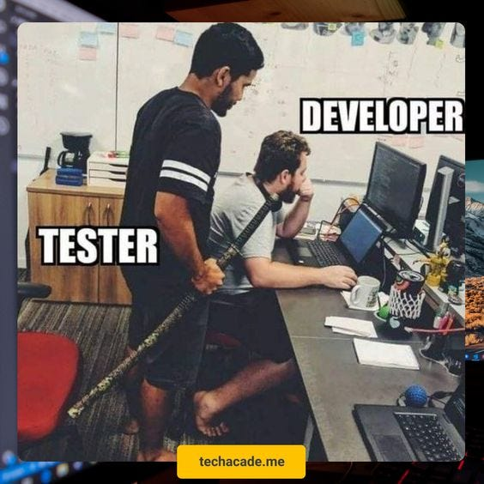

Software Engineering
WEEK 9
ENGR. Muhammad UMER HAROON

Slide 2
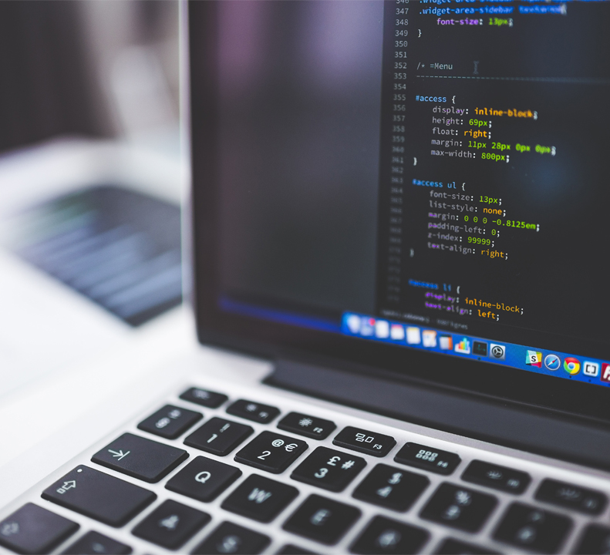
WEEK 9

Slide 3
Testing
According to ANSI/IEEE 1059 standard, Testing can be defined as - A process of analyzing a software item to detect the differences between existing and required conditions (that is defects/errors/bugs) and to evaluate the features of the software item.

Slide 4
Taught on board

Slide 5
SQE
SQA ---- ?
SQC -----?
Testing

Slide 6
Black Box Testing
gray box testing
White Box Testing

Slide 7
Testing continued

Slide 8
Verification vs validation
Verification: "Are we building the product right”.
The software should conform to its specification.
Validation: "Are we building the right product”.
The software should do what the user really requires.

Slide 9
Inspections and testing
Software inspections
Concerned with analysis of the static system representation to discover problems (static verification)
May be supplement by tool-based document and code analysis.
Software testing Concerned with exercising and observing product behaviour (dynamic verification)
The system is executed with test data and its operational behaviour is observed.

Slide 10
What Is Manual Testing?
Manual Testing is the process of testing the software manually.
When we use human resources to perform testing then we can consider the testing as Manual. In other words, in this type, we execute test cases manually. The skills, knowledge, and experience of the testers play an important role in Manual Testing.
What Is Automation Testing?
The usage of automation tools for executing test cases is known as Automation Testing. It is a type of testing for which we need resources with the knowledge of scripting, etc.
Selenium, QTP, UFT are some examples of automation tools. Selenium comes with C#, JAVA, Pearl, PHP, Python, and Ruby. Hence having knowledge of any of these listed languages will work.

Slide 11
Test-Driven Development (TDD) / Agile
Test-driven development (TDD) starts with tests. This type of development begins by discussing what you want to test and then creating a user story. So, you start by writing a unit test. Then you write the user story. Finally, you write the code until the unit test passes.
Test-driven development is typically used on unit and component tests — which can be done with automated testing tools. TDD makes sure the features are working as they should be.

Slide 12
A test case example
<?php
function test_addition()
{
$result = addition(1, 2);
if ($result !== 3) {
throw new Exception("1 + 2 should equal 3, but got {$result}");
}
}

Slide 13
Write code to pass the test

Slide 14
The code
<?php
function addition($a, $b)
{
return $a + $b;
}

Slide 16
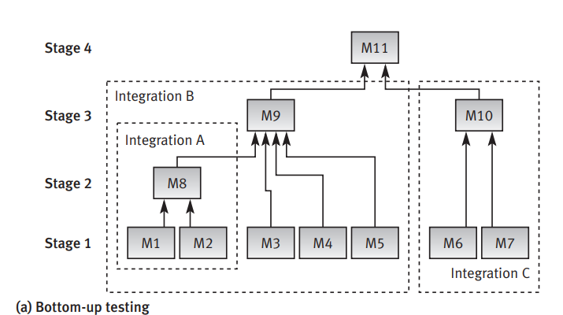

Slide 17
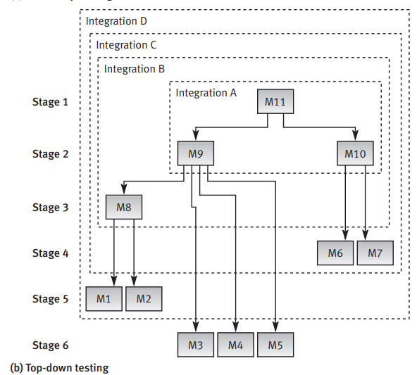

Slide 18
Other testing types
Alpha testing
Testing done when development is nearing completion; minor design changes may still be made as a result of such testing.
Beta-testing
Testing when development and testing are essentially completed and final bugs and problems need to be found before release.
Mutation testing
To determining if a set of test data or test cases is useful, by deliberately introducing various bugs.
Re-testing with the original test data/cases to determine if the bugs are detected.

Slide 19
Unit testing
Integration testing
User interface (UI) testing
Exhaustive testing
Selective testing

Slide 20
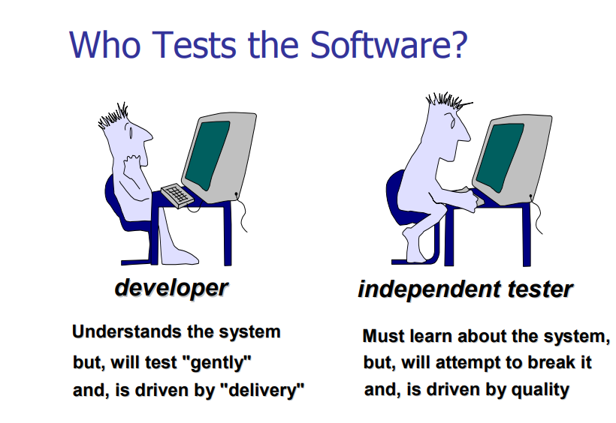

Slide 21

Ninth Week Summary
Here is what we learned

Slide 22
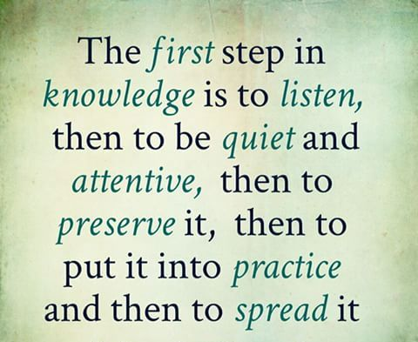
Thank You!

